Slide 1
MARKETING CAMPAIGN ANALYSIS OF A STORE
-Hafsha Wahab

Slide 2
TABLE OF CONTENTS
01
02
04
03
Background
Understanding KPIs
Recommended Analysis
Data Analysis
05
Recommendations to Client

Slide 3
01
Background
As a data analyst for Maven Marketing, I have analyzed marketing campaign data from 2,240 customers. This dataset includes detailed customer profiles, product preferences, campaign outcomes, and channel performance metrics. My analysis aims to uncover actionable insights that can inform future marketing strategies and optimize campaign effectiveness.
Data Source: kaggle.com/datasets/deepaksaw/marketing-dataset

Slide 4




02
Understanding the KPIs
Customer base
Campaigns
Best Selling Products
Marketing Channels

Slide 5
03
Recommended Analysis
Are there any null values or outliers? How will you handle them?
What factors are significantly related to the number of web purchases?
Which marketing campaign was the most successful?
What does the average customer look like?
Which products are performing best?
Which channels are underperforming?

Slide 6
04
Data Analysis

Slide 7
13,56,988
Total Sales from 2012 -2014

Slide 8
1) Are there any null values or outliers? How will you handle them?
We found 24 null values in the income section. These null values can be treated in various ways:
1) We can drop the null value records if the number of null values is insignificantly less and would not affect our data analysis.
2) Otherwise, we can also find the mean, median, mode or regression values of income under different categories and fill up those null values.
Here, I treated the null values by taking the mean of the income of different groups of people based on their marital status and educational qualification.

Slide 9
2) What factors are significantly related to the number of web purchases?
Some of the important factors that we can consider in the web purchases includes customers' demographics- Age, Education, Marital Status, Country.

Slide 11
3) Which marketing campaign was the most successful?
4th Campaign was the most successful campaign.

Slide 12
4) What does the average customer look like?
To understand the demography of the target customer we need to analyse the their age group, education, marital status, income, country.

Slide 13
As per our analysis, we can see that maximum of our Customers are Spanish married couples, born between 1963-1982, with Graduation degree and their income ranges between 26,730 - 76,729.

Slide 14
5) Which products are performing best?
Wine is the best selling product followed by Meat products.

Slide 15
6) Which channels are underperforming?
Deals purchases is the most underperforming channel.

Slide 16




INSIGHTS
Total Customers
Best Product
Best Campaign
Best Channel
2240
Wine
4th Campaign
Stores

Slide 17
05
Recommendations to Client

Slide 18
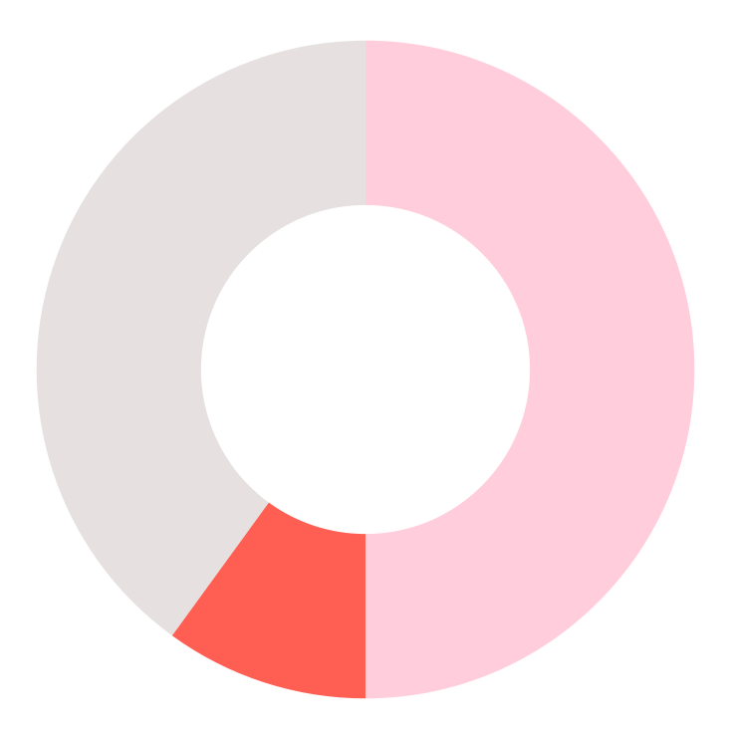
The 4th campaign is the most successful. The client should further investigate its strategies and replicate them in the starting campaigns itself.
The main customer base are married couples from Spain followed by in Saudi Arabia. Majority of their customers are graduates. Hence, the client should target customers from these countries and should offer more lucrative offers.
Apart from the stores, the client may also focus more on the web purchases as it has the potential to expand online marketing and building a strong customer base.

Slide 19
THANKS!
DO YOU HAVE ANY QUESTIONS?
linkedin.com/in/hafsha-wahab-767032159/

